Slide 1


SAP UI5 & FIORI with OData TRAINING using BAS
Anubhav Oberoy
Day – 11

Slide 2

Agenda – Day 11
Making Update call from UIMaking Delete call from UI
Calling the Function Import in the UI
Delivering our Fiori App
Adding deployment Configuration to our app
Deploying our app to the SAP ABAP Repository
Delivering our Fiori App
Adding deployment Configuration to our app
Deploying our app to the SAP ABAP Repository
Introduction to Git Hub
Understanding How GitHub Works
Steps to Create a Git Repository
Adding our Project to Git Repository
Fiori Launchpad
Accessing the Fiori Launchpad
Adding our app to Launchpad
Understanding the Basic Terms related to Launchpad

Slide 3
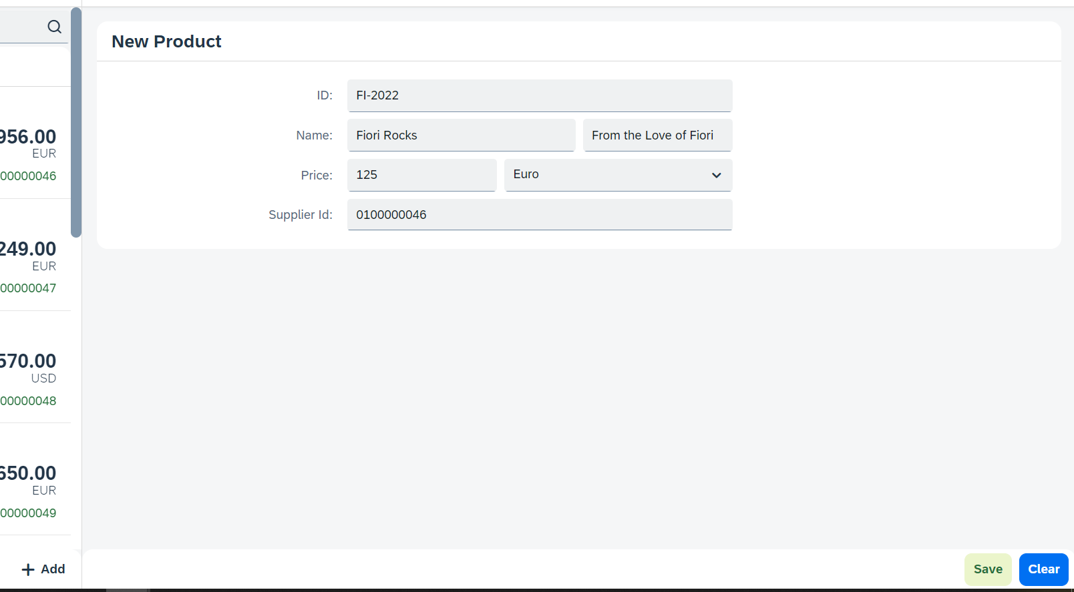
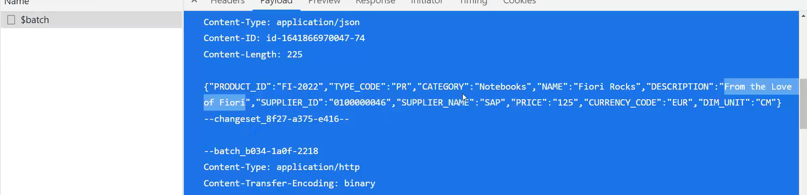
Hands – on: Making POST call from UI
Now we will add a new view named as Add. In this view will add a simple form to enter the product details and then on press of the Save a new Product will be created in the backend.
We will also add a Clear button to clear the form.
Code Link:
View1.view.xml
View1.controller.js
Add.view.xml
Add.controller.js
manifest.json

Slide 4































Flow for update

Slide 5
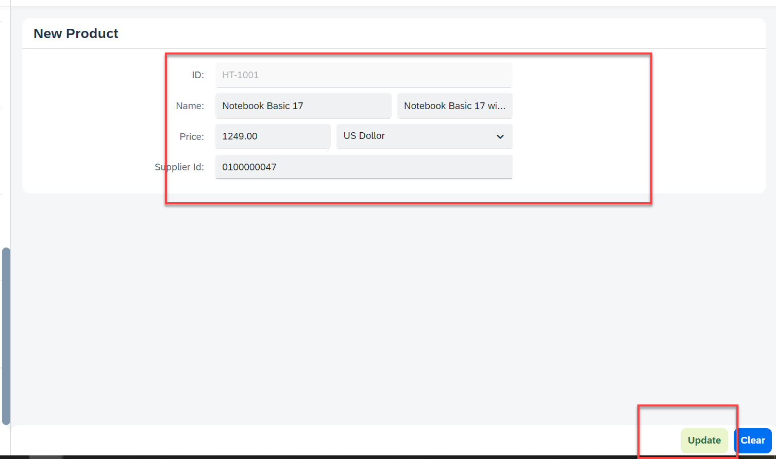
Hands – on: Making Update call form UI
Now will add a functionality to update a Record form the backed. But before that we will have to load the record in the form and then we will update that recode and save it.
Code Links:-
Add.view.xml
Add.controller.js

Slide 6
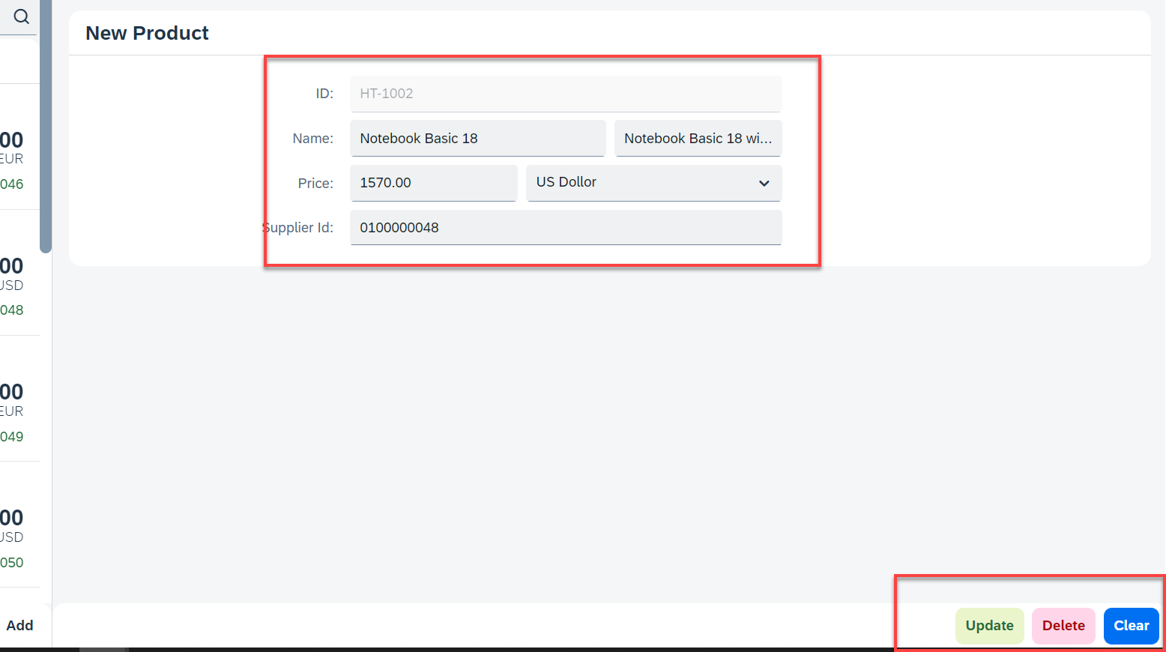
Hands – on: Making Delete call from UI
Now we want to delete a selected record form the UI. To do that we have to make a delete button in the UI and on press of that delete button the record will be deleted form the backend.
Code Links:-
Add.view.xml
Add.controller.js

Slide 7
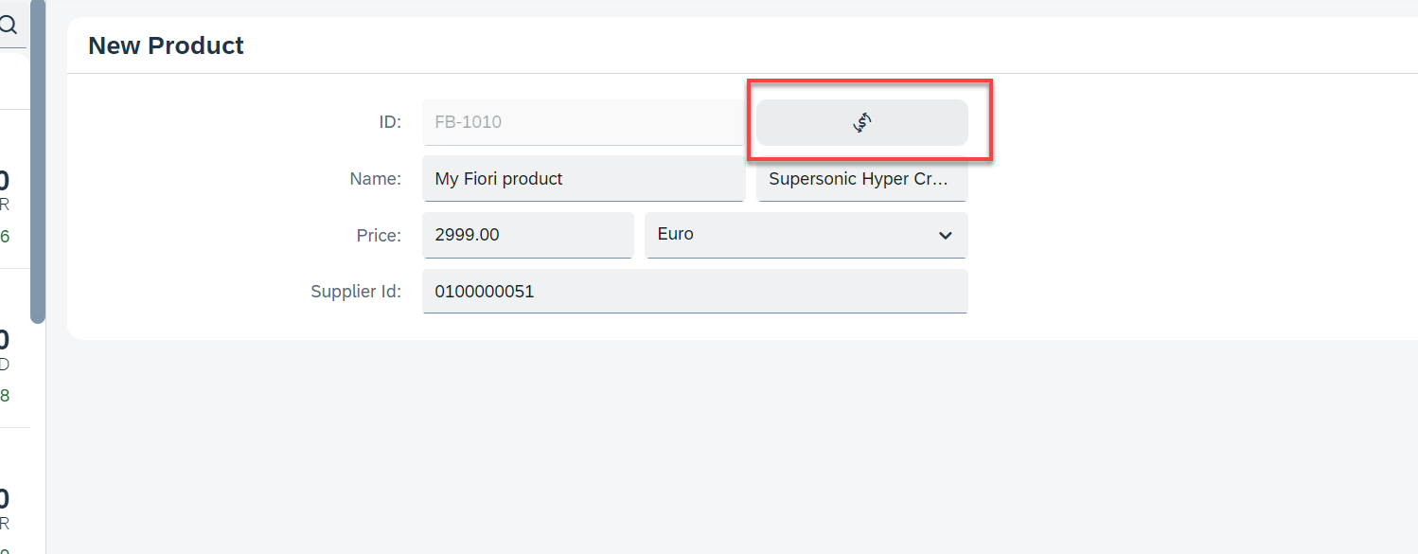
Hands – on: Calling the Function Import
Now load the most expensive data on the Add View. To do that we will add a button next to the Product ID field and on press of that button we will make a call to the Most Expensive Products function which we have created. And then load the data into the form.
Code Link:-
Add.view.xml
Add.controller.js

Slide 8

Introduction to Git and GitHub
Git is a version control system that lets you manage and keep track of your source code history.
GitHub is a cloud-based hosting service that lets you manage Git repositories.
Git HUB is a central repository to store all the code. Git is a distributed repository management system, which allows development teams to organize and sync their development code.
Use Case- I am working as a Fiori Developer in an MNC and I want to share my code with fellow developers, currently I am downloading the zip/tar file and sharing over email.
This way we will have piles of emails in our account,
especially when we work in a team of size 40 developers it becomes very hard to sync changes.
There is version control. Last night my app was stable, I made some changes this morning which messed up the whole project. I some how pray to god that can you please take me in past.
In a big team, many developers touching each other’s code and it’s hard to blame someone who disrupt the code.
It is also very hard to merge changes when done in same file.
As a developer, I am using BAS today, tomorrow I will use VS Code and next day Web IDE and very next week Atom. How can I easily port my code between these tools.
You can install git in local machine using below link (however, it comes along with all dev tools)
https://git-scm.com/downloads

Slide 9


How GitHub Works and commands in Git
We will see some important commands related to Git and will see how GitHub works.
Some important commands to use git.
git Init: It is used to initialize a new Git Repository in the system.
git add <filename>: It is used to stage the changes of the file to git repository. We can use ‘git add .’ to stage the changes of all files.
git commit: It is used to commit all the staged changes with a message.
git reset hard: Discard all the staged changes and discard the changes in all the files.
git push: It is used to push all the changes in the git repository.
git pull: It is used to pull the new changes made by other users in the project.
git status: It is used to check the status
git clone: It is used to clone a repository.
git remote add <repo URL>: Add a local repository to a remote repository.
Fiori Project (or any kind of project)
User (Anubhav)
But how all users will work on the project at a same time?
Anubhav’s local machine
Here GitHub comes into picture
Users which are working on the different parts of the same project on different Platforms (BAS, VS Code, Web IDE)
Project Repository
The project will be kept in a repository in the GitHub

Slide 10
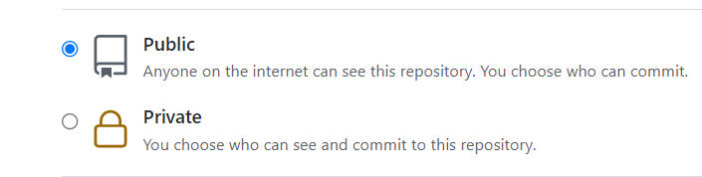
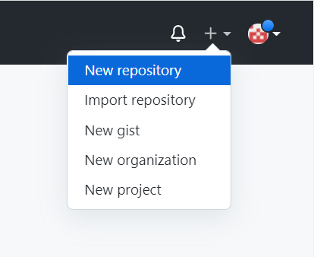
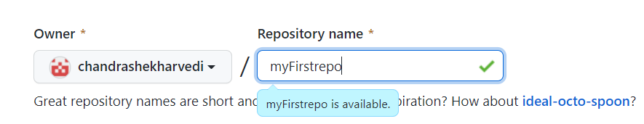
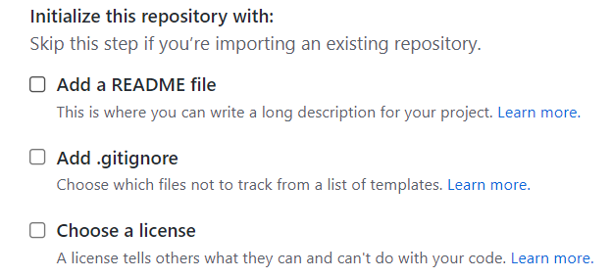
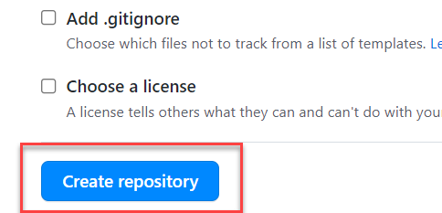
Steps to Create a new git Repository
Step by Step process to create a git repository in GitHub. First of all you must have a GitHub account, if not then go to this link https://github.com/signup?source=login and create a new Account.
Step 1: Click on the plus button in the top right corner of the screen and select ‘New Repository’.
Step 2: Type a short, memorable name for your repository. And give a description (optional).
Step 3: Select the type of repository. Public or Private
Step 4: Set how you want to Initialize the repository.
Step 5: Click on Create Repository. Your Repository will be created.
Repository Created Successfully

Slide 11


Adding project to git repository
Project on Local System
1
git init
Initialize a git repo
2
git add .
Stage all the changes
3
git commit –m “message”
git pull
Once the project is connected to git repo then we just use the git pull and git push commands to get the new changes and send our changes
Stage all the changes
git push
5
git add remote <repo URL>
Add the remote branch
GitHub Repository
git push
5
Clone repository for the first time in system
git clone <repo URL>
GitHub Repository

Slide 12
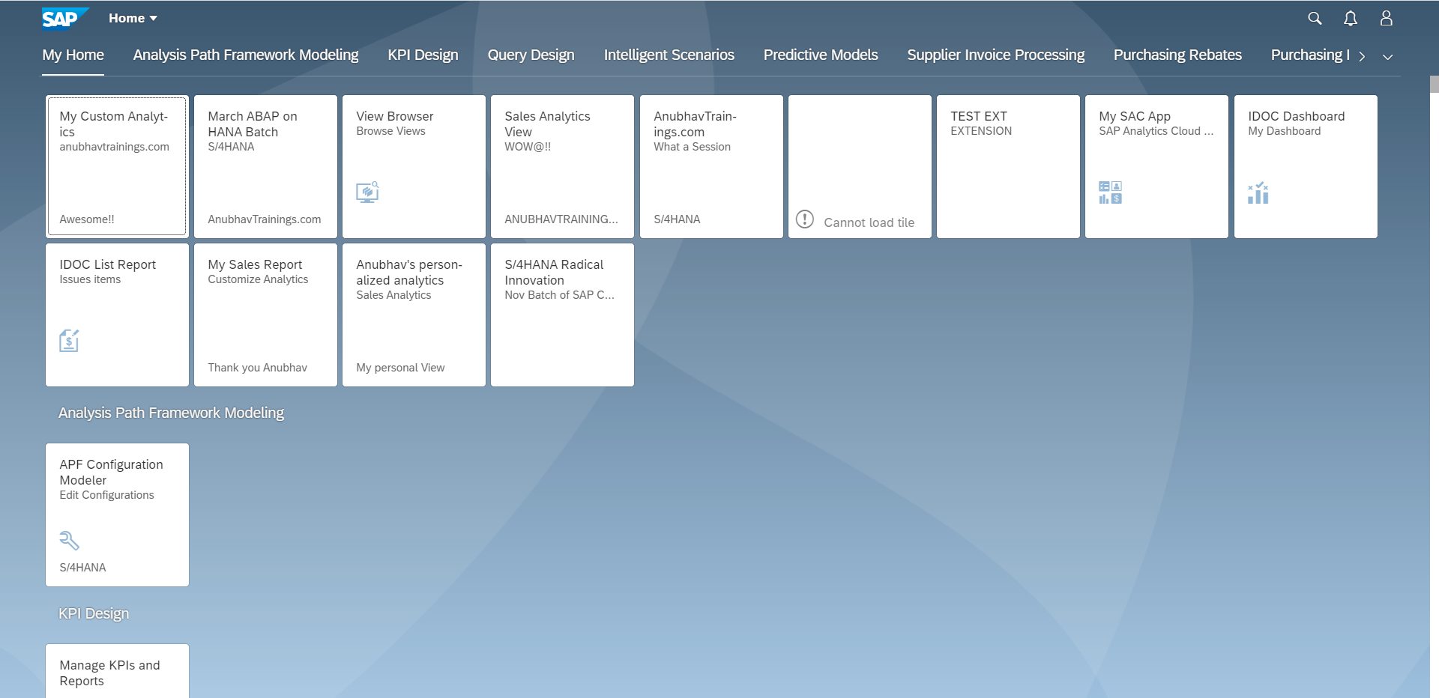
Fiori Launchpad
SAP Fiori Launchpad is a single access point for all the Applications in S/4HANA. Is available fiori frontend server once Fiori is installed in your SAP System.
The SAP Fiori launchpad is a shell that hosts SAP Fiori apps, and provides the apps with services such as navigation, personalization, embedded support, and application configuration.
The launchpad is the entry point to SAP Fiori apps on mobile and desktop devices. The launchpad displays a home page with tiles.
Each tile represents a business application that the user can launch. Tiles can also display live status indicators, such as the number of open tasks.
The launchpad is role-based. In other words, the user’s role determines which app tiles are shown.
Launchpad comes with Launchpad Designer (LPD), which allows developer/consultant to configure access to the apps as a Tile.
The TCode to access:
Launchpad: /N/UI2/FLP
Launchpad Designer: /n/UI2/FLPD_CONF

Slide 13
Why we require Launchpad
Just imagine, if my co. have developed 500 Apps in last Quarter, These 500 apps have got 500 URLs to access the app. As a end user, you would face below challenges
Finding URL for each app is a challenge
Making sure that you are right person to access app – Security
Also you should only be able to see apps which you are allowed to access
SAP Portal is now deprecated, what options do we have to access all functionality of ERP
Type of Fiori App Implementation
There are two types of Fiori App Implementations: Standard Apps and Customized Apps.
Standard Applications
Customized Apps
Implementation of those business apps, which are released by SAP
These are categorized as Transnational, Fact-sheets and Analytical apps etc.
As per business requirement, a complete custom fiori app can be implemented.
Customized App is been hosted on SAP-Fiori server (front-end system).
It integrates with SAP or Non-SAP system.

Slide 14
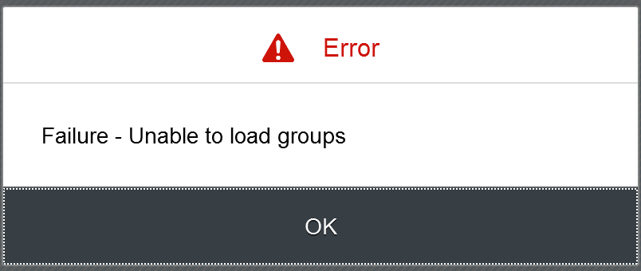
Fiori Launchpad Access
The service which is used by Launchpad to run
/UI2/INTEROP – This service controls navigation from tile to the Application
/UI2/PAGE_BUILDER_PERS – Launchpad personalization, Used to load all the tiles, groups of users, controls the loading of launchpad content for our users.
Trouble shooting:
The service is not even registered
The service is not even activate
You may not have authorization to access this service.

Slide 15
Basic Terms related to the Launchpad
Catalog – A Collection of all the Tiles, Each tile represent precisely one Application. We create catalog to package all tiles together according to team, functional area, application component, functionality, area of responsibility…
Tile – a square box which provides entry point for an app, it consists of 2 parts,
Tile Properties – title, subtitle, icon, ..
Intent - Semantic Object + Action
Semantic Object – The business object which is involved in the activity. Area of interest. E.g. SalesOrder, PurchaseOrder, OutboundDelivery, Customer, Vendor, Sales,..
Action – Define the purpose of our Fiori Application. Indicative of the Activity which we want to perform on Business object. E.g. Create, Change, Manage, Track, Maintain, Execute, Analyze
Intent ➔ SalesOrder-manage, OutboundDelivery-track
Note: Every application in entire system has unique intent.
3. Target Mapping – Maps the intent with the actual Fiori App, WeBGUI, Tcode, Webdynpro App.
4. Group – Is used to group tiles logically from business point of view, We never create tiles in group. We reference tiles in the group from catalog.
5. Role – A user will be granted a role and inside the role we will have the catalog and the group.
intent
Tile
Tile 1
Fiori App
Tile
Tile 2
Target Mapping

Slide 16
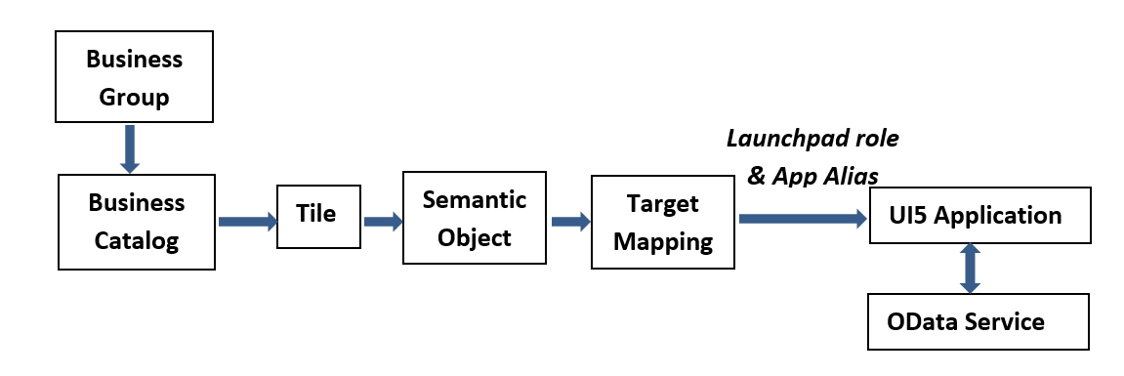
Relationship between Front-End Components

Slide 17
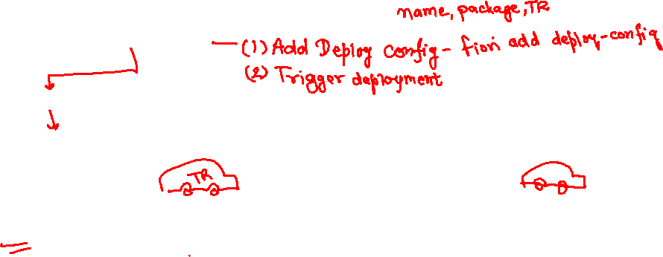
Delivering Fiori Apps
Currently the Application we have developed is in our local system (VS Code or BAS). Now we want this app to be accessible by other people in our company, to do that we have to deploy this application to our ABAP environment or cloud platform where it can be accessed by others.
BAS/VS Code
GitHub
Development Team
destination
SCC
DEV
QLT
PROD
BSP App
BSP App
BSP App

Slide 18














Slide 19





Delivering Fiori Apps
2
ui5 build
Development Environment
(BAS, VSCode, etc.)
1
git push
dist
GitHub Repository
3
npm run deploy-config
Developer
deployment configuration
End Users
4
npm run deploy
ABAP Repository
PROD (P)
DEV
Quality(Q)
Transport Request
Transport Request
Admin
Launchpad and Launchpad Designer

Slide 20
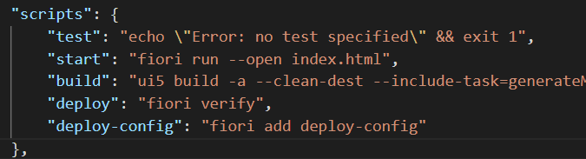
Adding deployment Configuration to App
Steps to configure the Application to deploy the Application on ABAP Environment.
Open the terminal in BAS or VS Code and go to your project folder.
Open terminal in you project folder.
Write command ui5 build or npm run build and press enter to build your project it will create a dist folder.
Now write command npx fiori add deploy-config to configure the project for deployment.
Select a target ABAP system … http://103.207.171.202 in your case your hostname will come in this step.
Enter the ABAP system client number …
Enter a username …
Enter a password …
Enter an application name …
Enter a description for the application …
Enter a package for the deployed application … $TMP
Now to deploy the application to the ABAP repository we use the command npm run deploy.

Slide 21
Title
Content

Slide 22

End of Day 11

Slide 23

Questions

Slide 24

Anubhav Oberoy

Slide 25


We’re committed to empower you to be
Most Desirable Resource
through powerful training solutions.
We build the workforce of the future.
250+
Corporate Clients
30,000+
Learners Trained
25000+
Learners Placed
FREE WEBINARS
Sign up for free webinars with industry experts every fortnight!
Enroll Now!
Contact us today!
https://anubhavtrainings.com/

Slide 26




More from AnubhavTrainings.com

Slide 27
Title
Content

